Slide 1
Qum Dabar
The promise is fulfilled

Slide 2
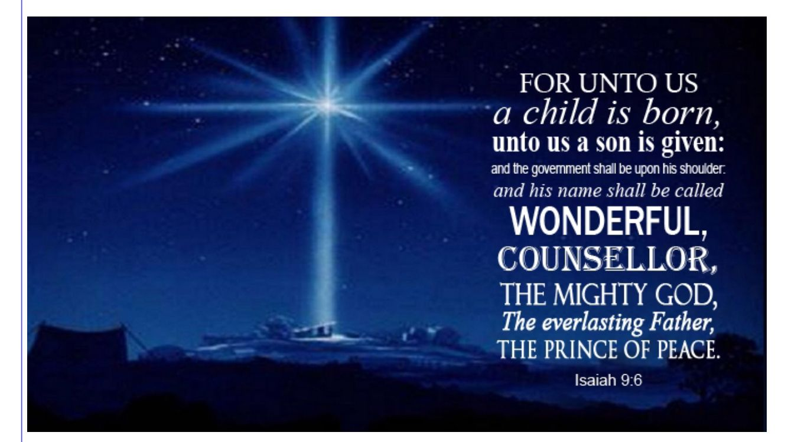
Isaiah 9:2-7

Slide 3

wonderful counsellor

Slide 4
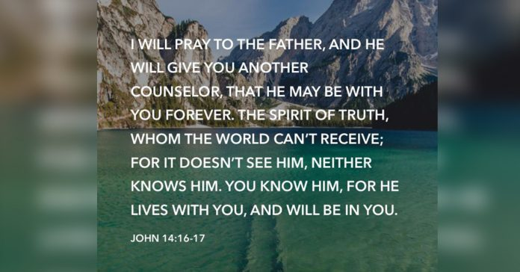
John 14:16 another counsellor

Slide 5

Mighty is our God

Slide 6
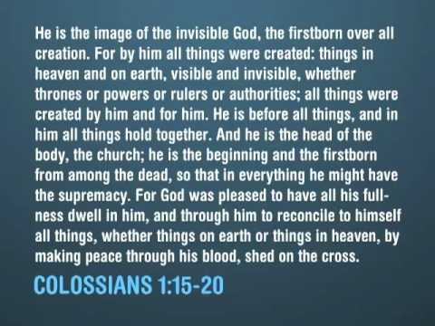
Colossians 1:15-20

Slide 7
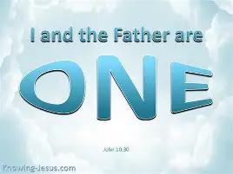
John 10:30

Slide 8
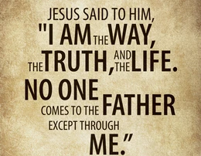
John 14:6

Slide 9

Everlasting Father

Slide 10
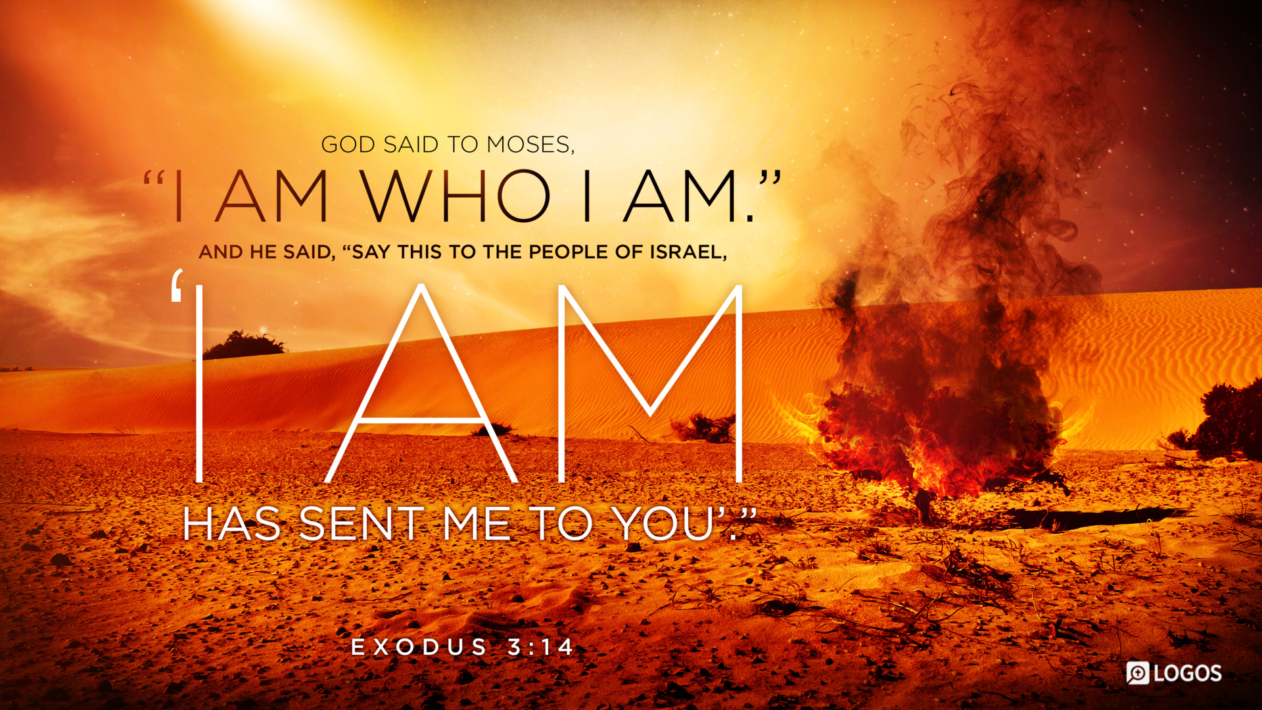
Exodus 3:13-14

Slide 11
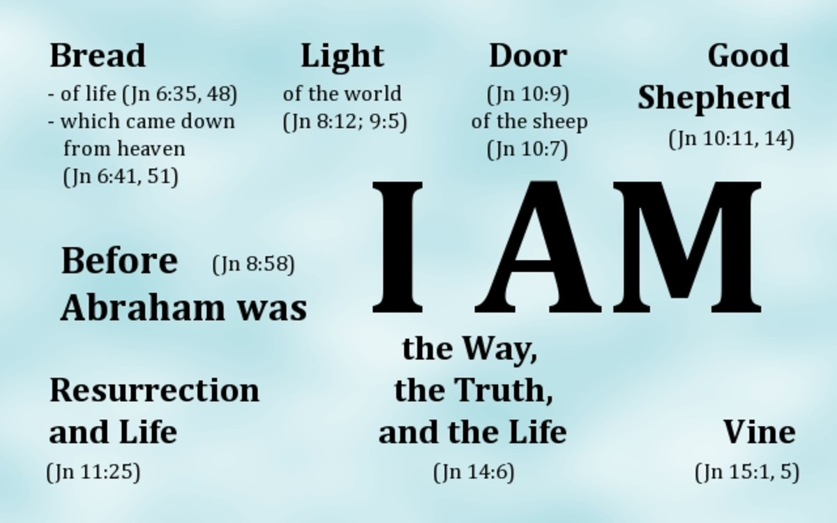
The 7 “I am” statements of jesus

Slide 12

Prince of peace

Slide 13
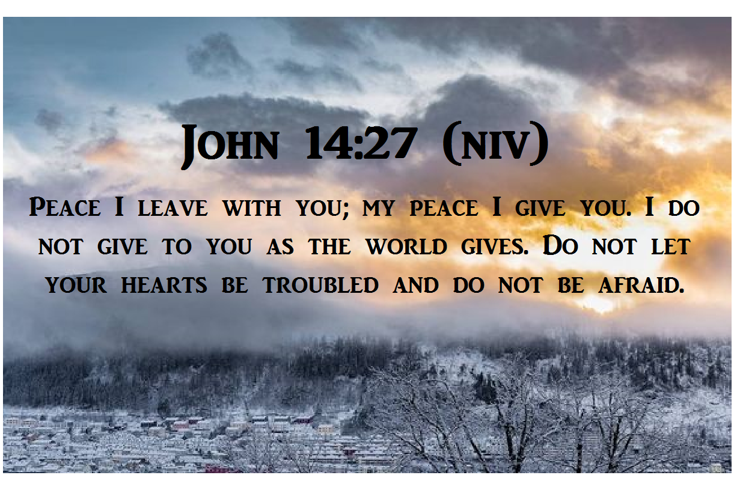
John 14:27

