Slide 1
Dektos Thusia
Acceptable Sacrifice

Slide 2
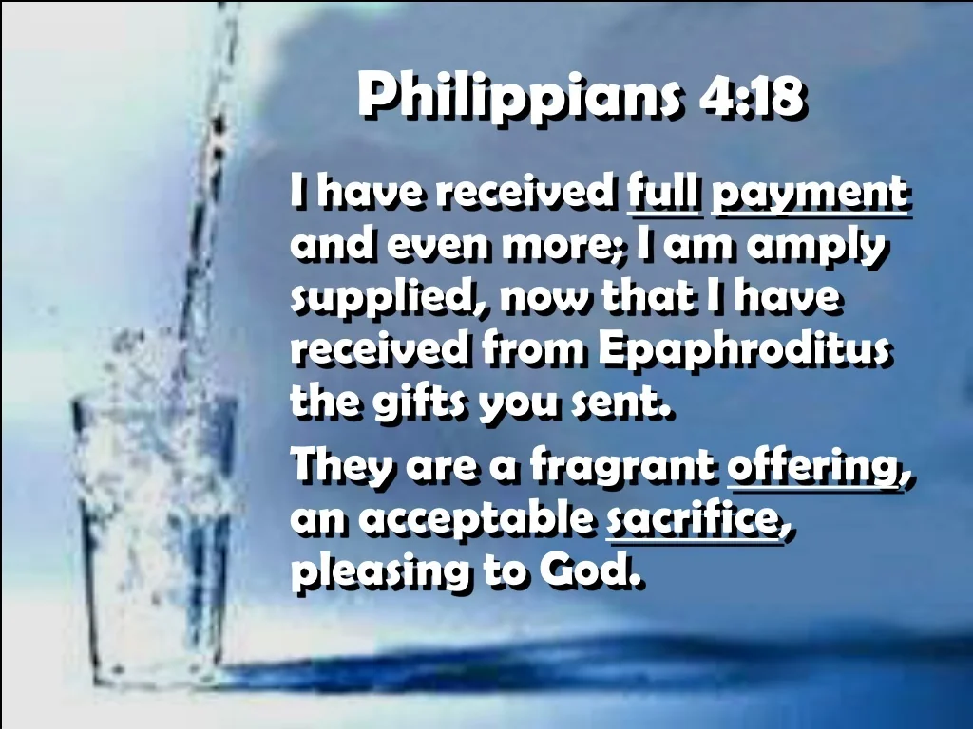
Philippians 4:10-19

Slide 3
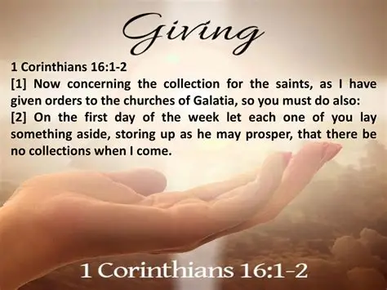
1 Corinthians 16:1-2

Slide 4
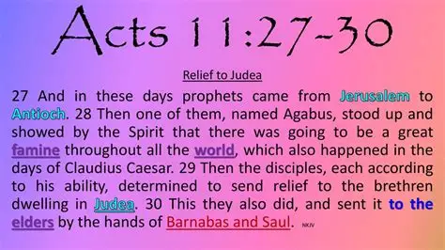
Acts 11:27-29

Slide 5
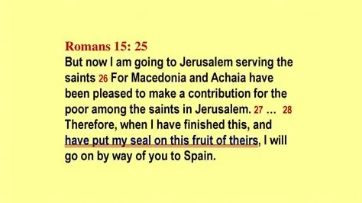
Romans 15:25-27

Slide 6
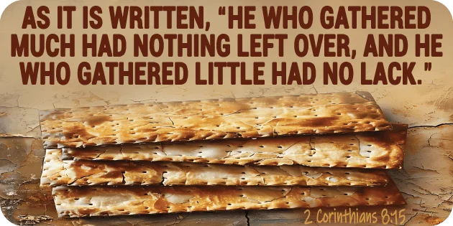
2 Corinthians
8:13-15
Exodus 16:8

Slide 7
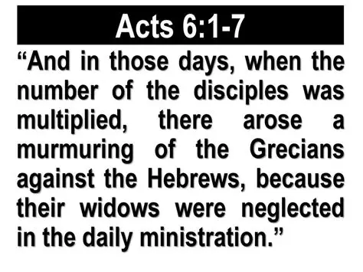
Acts 6:1-2

Slide 8
Biblical principles for supporting the poor
Is a potential source of conflict Acts 6:1-7
The church has an obligation to help the true needy James 1:27
The church must discern who the truly needy Are
1 Timothy 5:3-4 2 Thessalonians 3:10-11 1 Timothy 5:8 I Timothy 5:9-10
1 Timothy 6:8

Slide 9

Proverbs 11:24

Slide 10
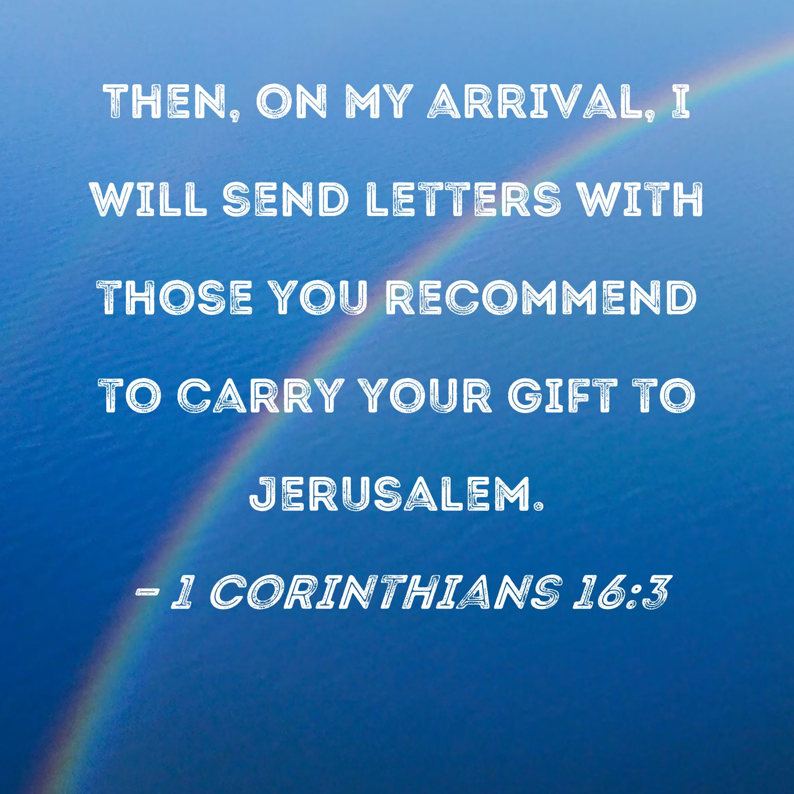
1 Corinthians
16:3-4

Slide 11
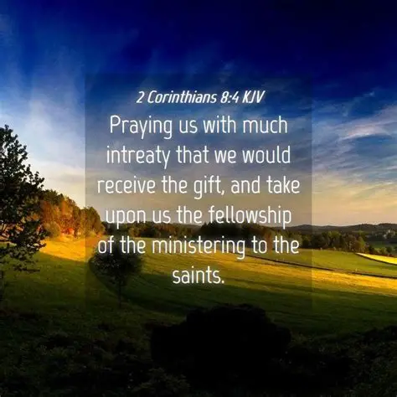
2 Corinthians
8:4

Slide 12

1 Corinthians
16:5-9

Slide 13

1 Corinthians
16: 10-11

Slide 14

1 timothy 4:12

